Slide 1
Obtaining Low-Level Control in a High-Level Language : Variant Types in Data-Parallel Array Languages
Presented by Luuk de Graaf
Luuk de Graaf

Slide 2
Introduction
Empty

Slide 3

Example : casus
Raytracer intersection
Data-parallel

Slide 4
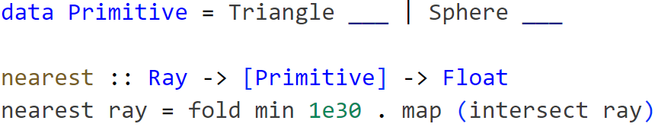
Example : solution 1 (ADT)
Empty

Slide 5
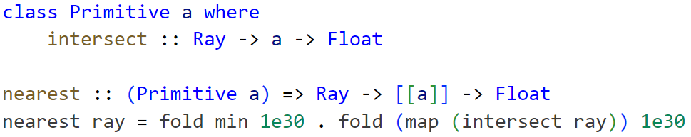
Example : solution 2 (interface)
Empty

Slide 6
Example : Issue (prevent abstraction)
Abstraction
Meta-programming
Low-level control

Slide 7
Performance : what if possible
Memory Representation
Cache
Vectorization
Branching/Divergence
Bottleneck: Memory bound vs Compute bound

Slide 8
Performance : data structures options
Element-wise
Tagged Union vs Pointer
Variant-wise
Parallel Arrays
Random Access

Slide 9
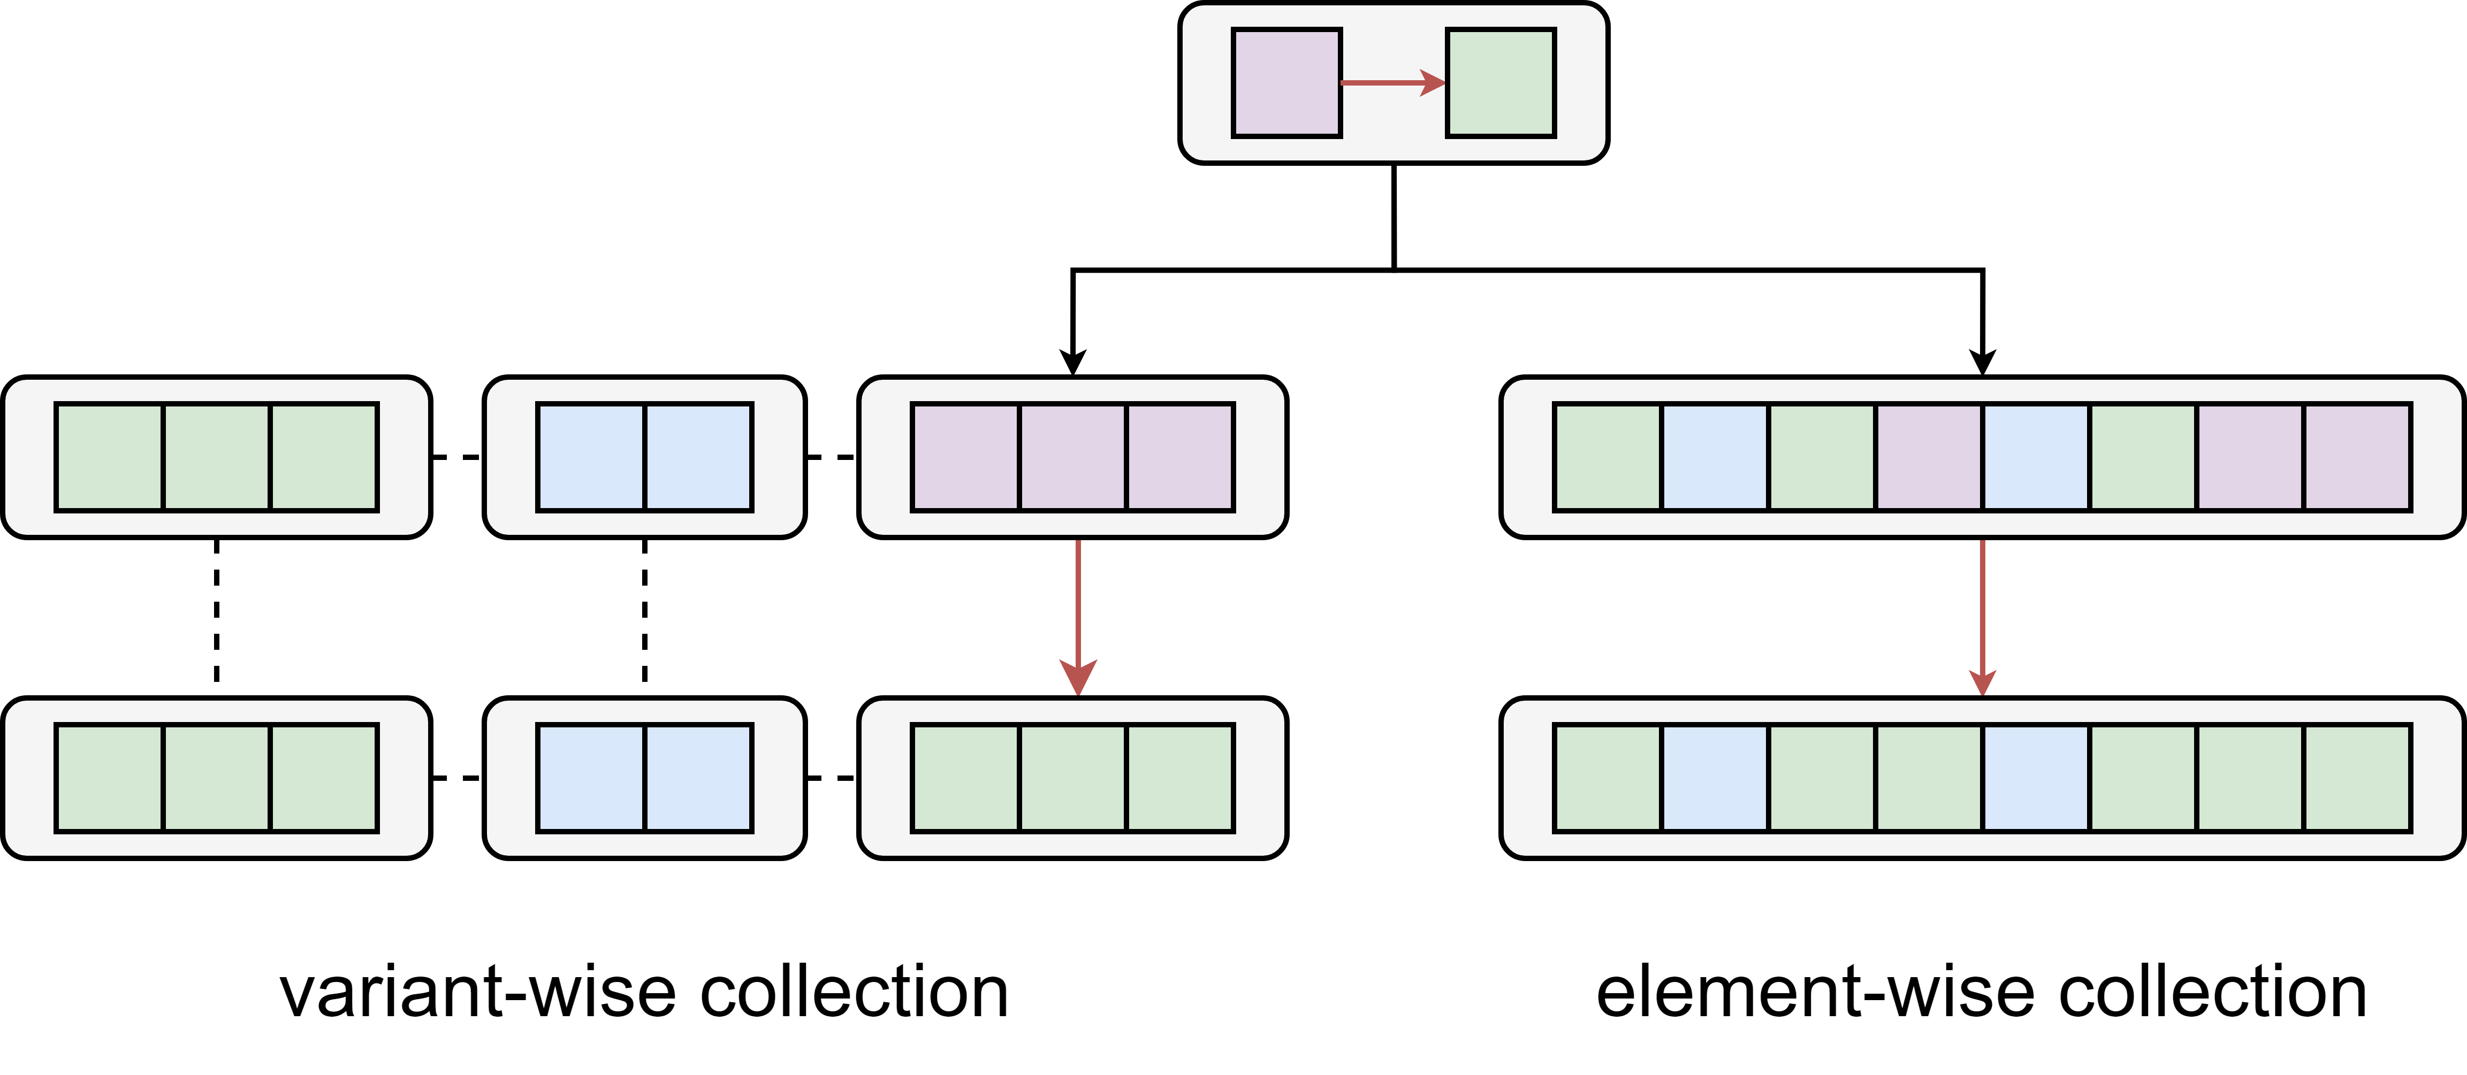
Performance: exhaustive
Subset Variants

Slide 10
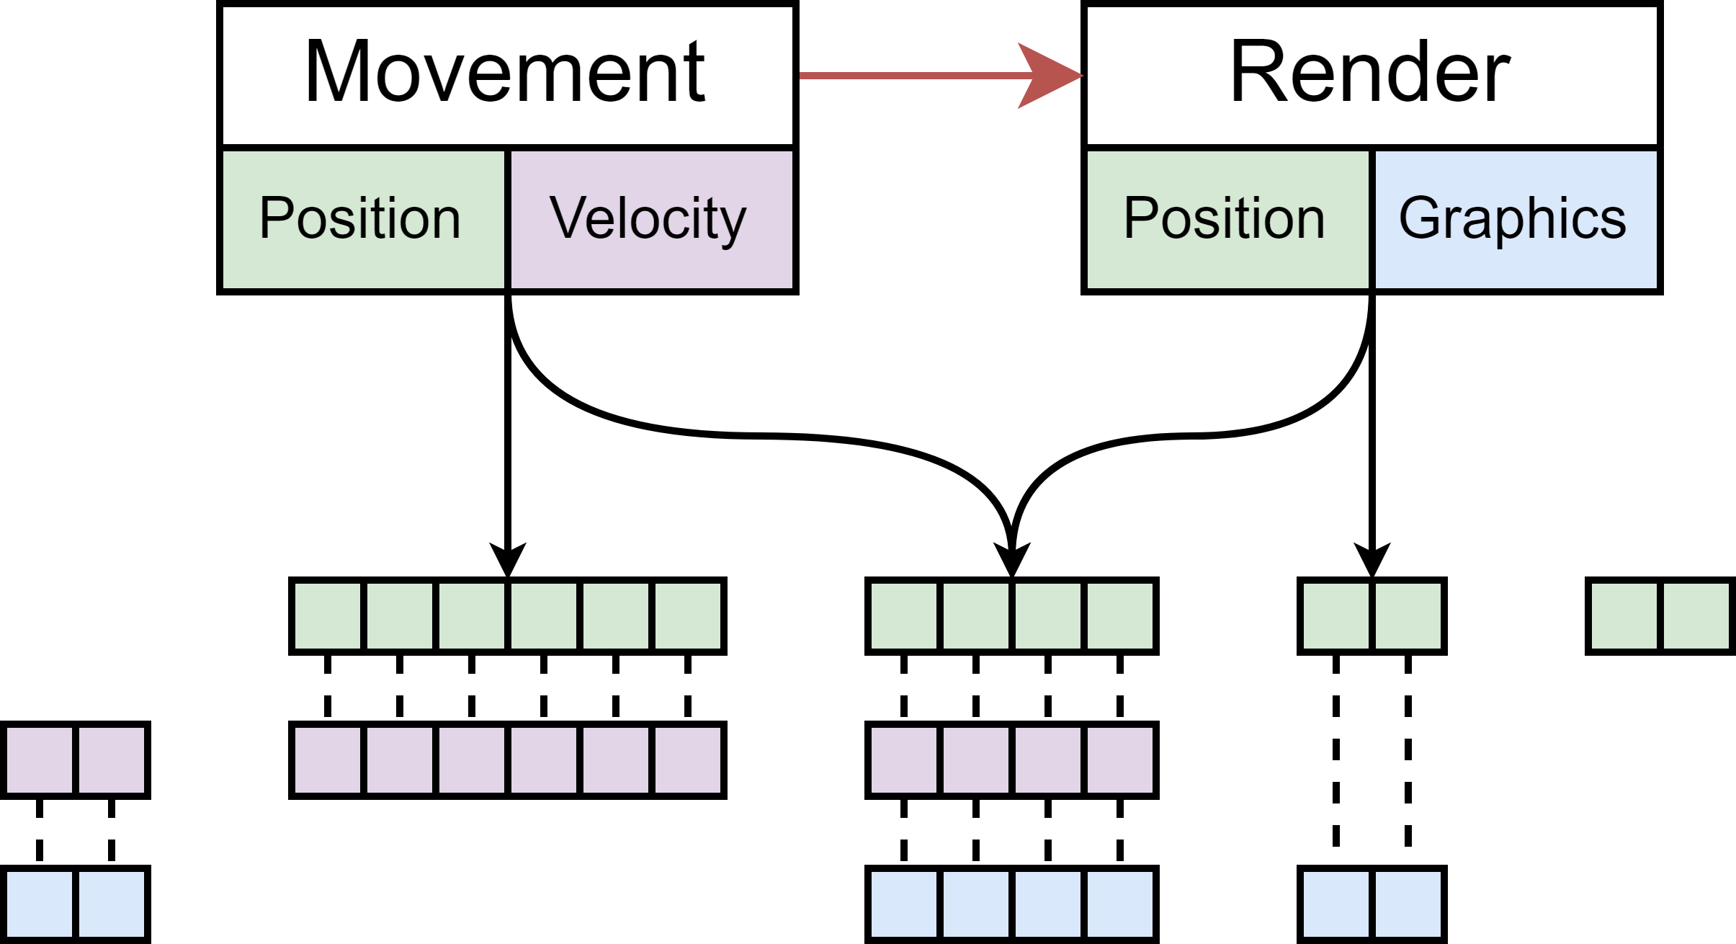
Solution : ECS
Entity Component System

Slide 11
Solution : ADT

Slide 12
Proposed Solution : Polymorphic Variants

Slide 13
Requirements
Haskell

Slide 14
Type-Level Programming

Slide 15
Datatype-Generic Programming

Slide 16
Notes:
Any questions?

